Slide 1
HDB Price Prediction
Group 4
Group Members: GUO HAONAN HUANG YUWEI
JIA JIA LU RUNNAN

Slide 2





Contents
Dataset and Preprocessing
Exploratory Data Analysis
Price Prediction and Results
Reflection and conclusion

Slide 3
PART 01
Dataset and preprocessing

Slide 4
DATASET
5 Datasets
918,909 Rows
Monthly Resale Transactions
1990 to Feb 2024
Flat Features
Month
Town
Flat Type
Block
Street Name
Storey Range
Floor Area
Flat Model
Lease Commence Date
Remaining Lease
Resale Price
Resale Dataset
Relationship
1 Dataset
106,076 Rows
Monthly Transactions
From Jan 2021 to Dec 2023
Flat Features
Rent Approval Date
Town
Block
Street Name
Flat Type
Rental price
Rental Dataset
Relationship

Slide 5
Data preprocessing
Things we did (For both Resale and Rental dataset) | Problems
Renamed Flat Type and Flat Model | different names of the same kind
Deleted the data without corresponding latitude and longitude | without corresponding latitude and longitude
Extracted the year and month label separately from time label | time label including both year and month
Things we did (Specially for Resale dataset) | Problems
Calculated the Remaining Lease | missing value
Merged the intervals for Storey Range as floor level | some intervals which have the intersection
Things we did (Specially for Rental dataset) | Problems
Added one new variable called Month Increment | time range too short (3 years)

Slide 6
Part 02
Exploratory Data Analysis

Slide 7
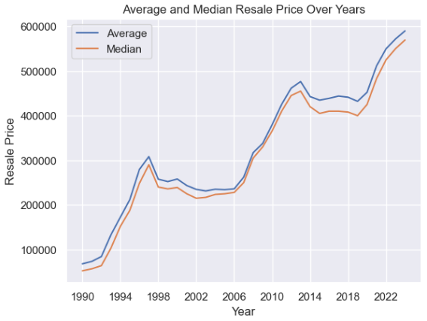
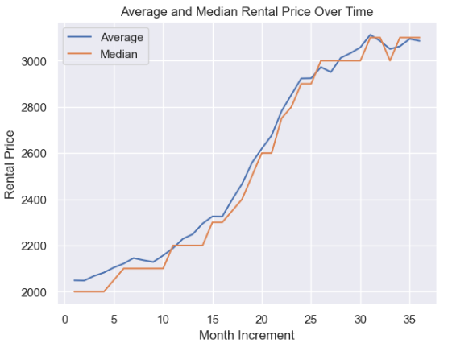
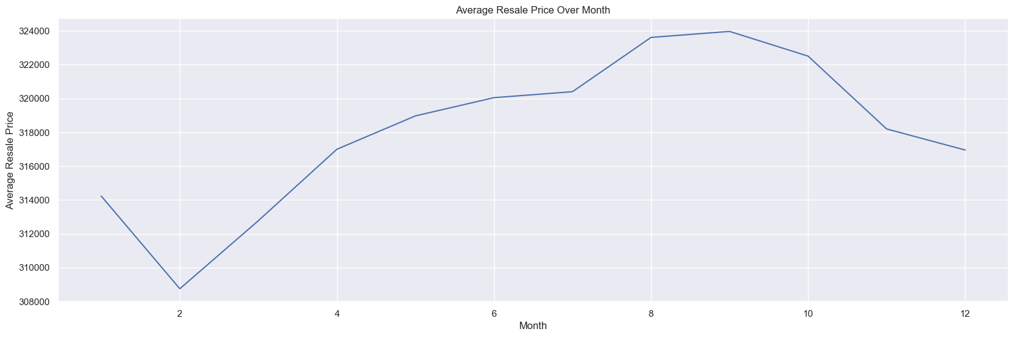
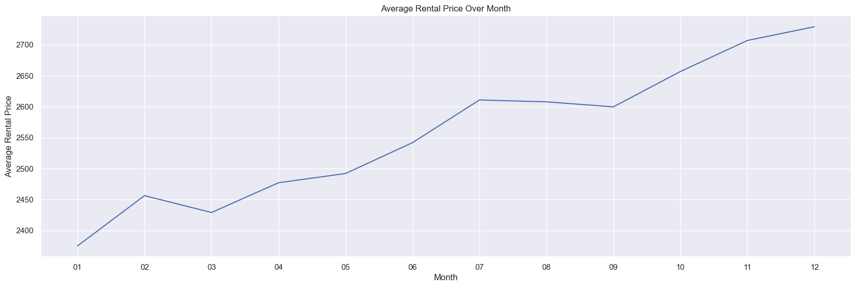
Median and Mean of HDB price over time
We should import Year and Month for Resale in our model.
We should import Month increment and Month for Rental in our model.
Resale Price
Rental Price

Slide 8
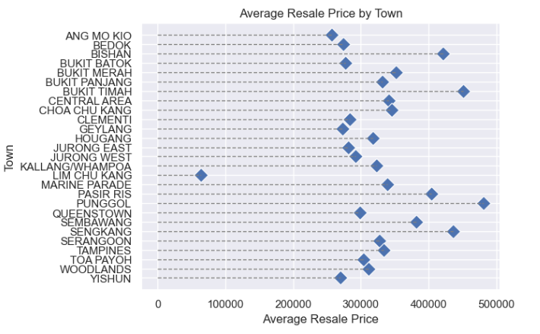
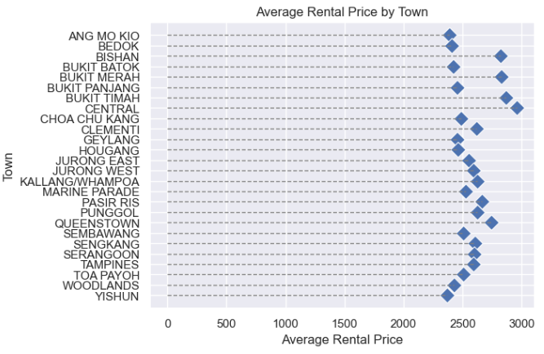
HDB Price by Town
The Town feature has an influence on HDB Resale or Rental Price.
Resale Price
Rental Price

Slide 9
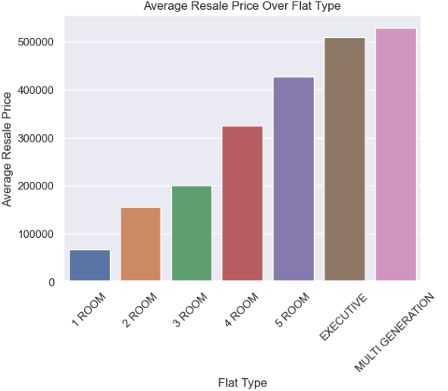
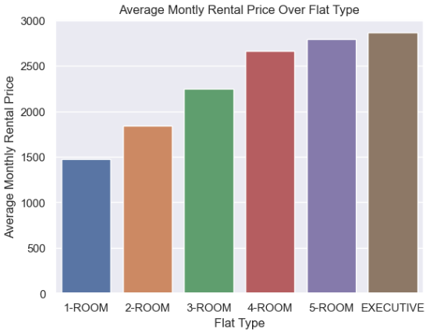
HDB price by Flat Type
The Flat Type feature has an influence on HDB Resale or Rental Price.
Resale Price
Rental Price

Slide 10
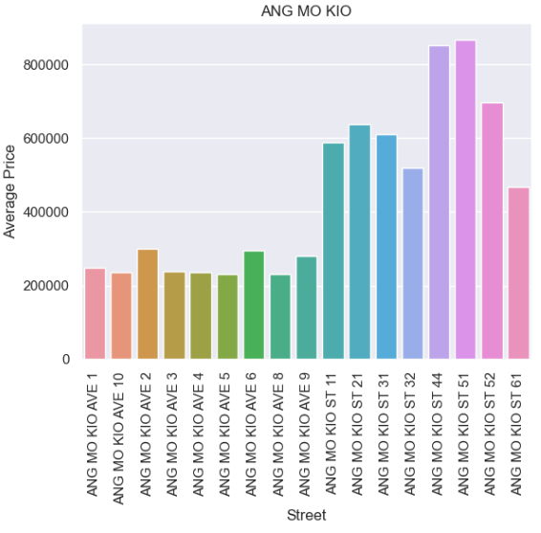
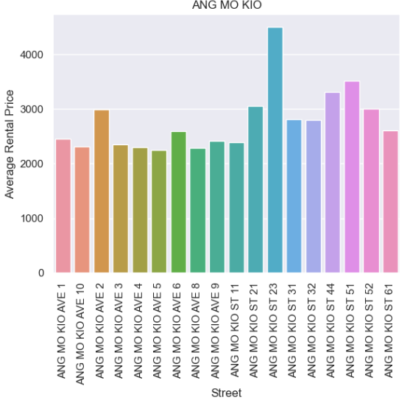
HDB price by Street Name
The Street Name feature has an influence on HDB Resale or Rental Price.
Resale Price
Rental Price

Slide 11
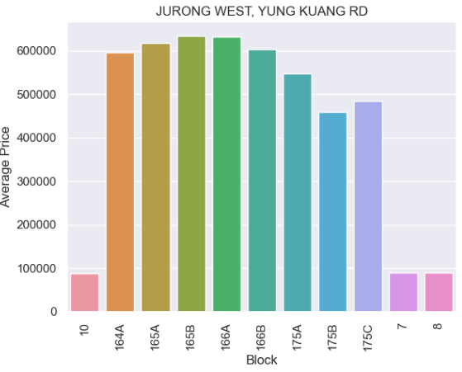
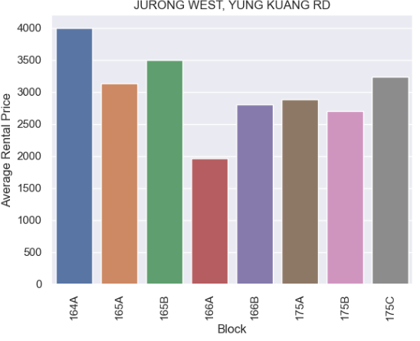
HDB price by Block
The Block feature has an influence on HDB Resale or Rental Price.
Resale Price
Rental Price

Slide 12
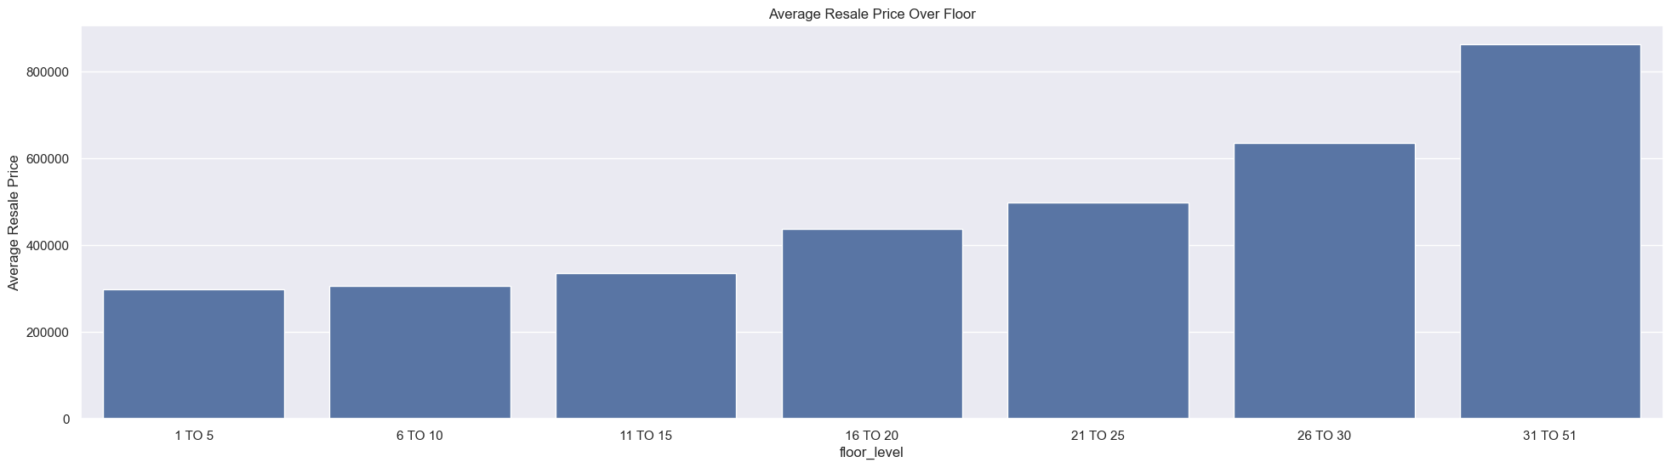
HDB price by Floor Level
As floor level becomes higher, resale prices will increase. Therefore, we decided to use this feature.
Resale Price

Slide 13
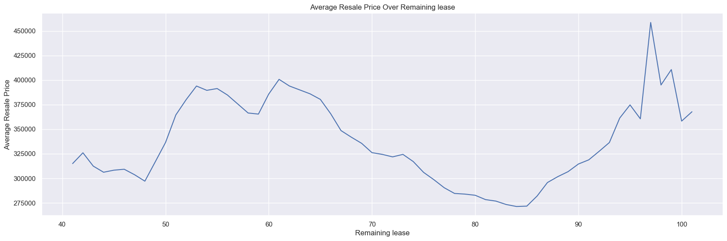
HDB price by Remaining Lease
It's hard to say the duration of remaining house lease is correlated with resale prices. Therefore, we decided to discard this feature.
Resale Price

Slide 14
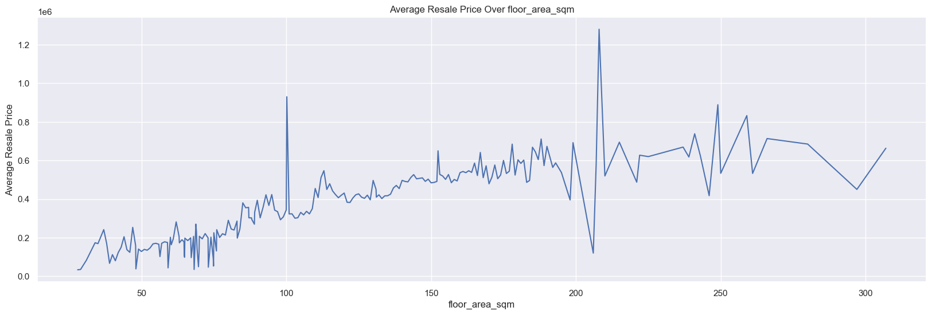
HDB price by Floor Area
Removing some outliers, we can find the house area has an obvious positive impact on price.
In addition, considering we often using metric Resale Price per Unit of house to measure in reality, we handle our y as unit_price = resale_prices/floor_area_sqm.
Resale Price

Slide 15
PART 03
Price Prediction and Results

Slide 16
Feature Selection
After analyzing the correlation between all features and label, we choose several features which have great impact on price.
For Resale Dataset:
For Rental Dataset:
Features
Year
Month
Town
Street Name
Block
Flat Type
Floor Level
Flat Model
Features
Month Increment
Month
Town
Street Name
Block
Flat Type

Slide 17
Data Preperation
Resale Features
Year
Month
Town
Street Name
Block
Flat Type
Floor Level
Flat Model
One-hot Encoding
Year
Month Town
Flat Model
Ordinal Encoding
Street Name
Block
Flat Type
Floor Level
Rental Features
Month Increment
Month
Town
Street Name
Block
Flat Type
Standardization and Normalization
Month Increment

Slide 18
Regression Model
Linear Regression Model
Decision Tree Regression Model
We set the max depth = 20
(Also try Random Forest Model)
AdaBoost Regression Model
We set the number of weak learners = 50
Multi-Layer Perceptron
We set two hidden layers
The number of neurons in each layers is 50 and 20 respectively.
We attempted to set up a deeper or bigger neural network, but them saw virtually no improvement

Slide 19
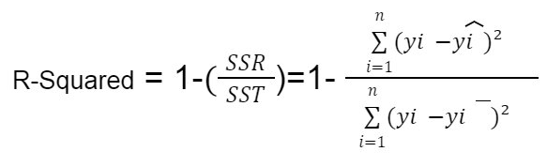
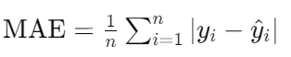
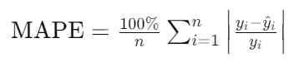
Model Evaluation
We mainly evaluate the model's performance from the perspectives of error and data variability. We use R-square score, Mean Absolute Error and Mean Absolute Percentage Error as evaluation metrics.
Evaluation metrics:
MAE (Mean Absolute Error)
MAPE(Mean Absolute Percentage Error)

Slide 20
Results of Regression Model
Resale: R-square ~= 0.95
Rental: R-square ~= 0.3 to 0.5
(closer to 1 => better)
 | MAE | MAPE
Linear Regression | 417 | 14%
Decision Tree Regression | 464 | 19%
AdaBoost Regression | 1384 | 70%
Multi-Layer Perceptron | 145 | 5%
 | MAE | MAPE
Linear Regression | 407 | 17%
Decision Tree Regression | 414 | 17%
AdaBoost Regression | 427 | 18%
Multi-Layer Perceptron | 407 | 16%
Resale Price per Unit
Rental Price

Slide 21
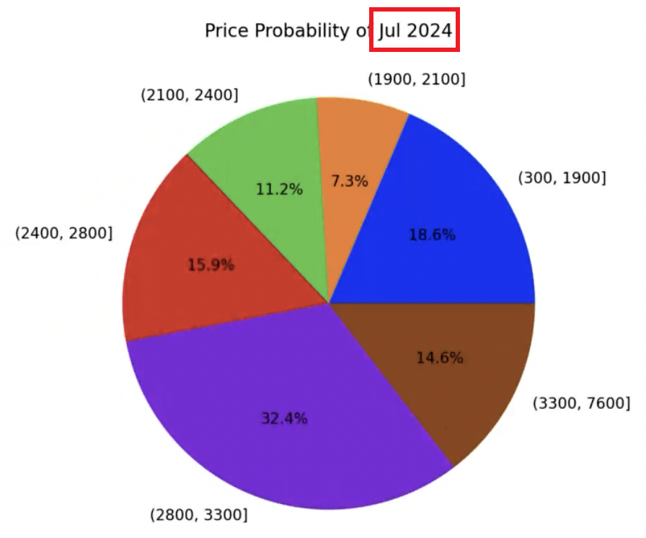
Other Attempts: Classification Model
From perspective of mathematics, we can also regard this problem as a classification problem after converting numerical label into categorical labels.( set the interval range of price and treat it as different categories.)
Classification Model used to predict:
Logistic Regression
AdaBoost Classifier
Multi-Layer Perceptron Classifier
Decision Tree Classifier

Slide 22
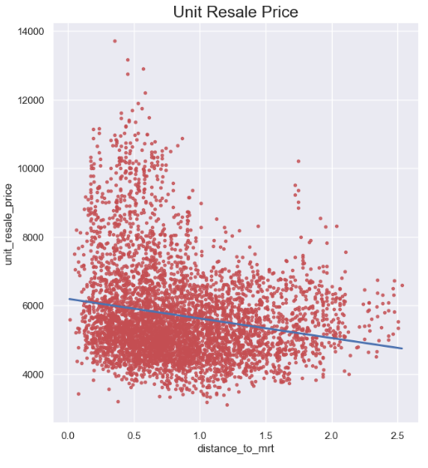
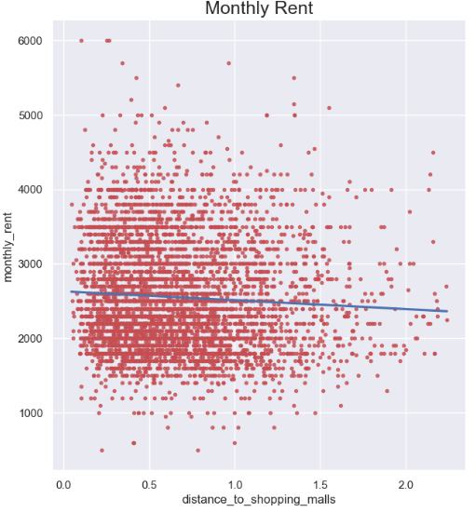
Other Attempts: Supplementary Feature
We add several features which we suppose are helpful to our model
MRT Information
Distance to nearest MRT station
Name of nearest MRT station
Primary School
Distance to nearest Primary School
Name of nearest Primary School
Shopping Mall
Distance to nearest Shopping Mall
Name of nearest Shopping Mall
These features indeed have a certain correlation with the price.
Contribute little to result of prediction
Significantly increased the training costs and time.

Slide 23
PART 04
Reflection and Conclusion

Slide 24
Conclusion
Resale prediction:
Our model can predict Resale Prices with relatively high accuracy
Performs well in R-square, MAE, and MAPE
Rental prediction:
Our model's price predictions are satisfactory on the MAE and MAPE metrics, though performing slightly worse than Resale prediction.
However, poor in ability of predicting data variability
R-sqare ~= 0.45
The MAE and MAPE of Dummy Model(use mean price of training set as prediction) is only 577 and 0.24!
Although features⬆ => score⬆(sometimes increase only a little), but training time and costs⬆. So it’s better to discard some features!

Slide 25
Reflection
To achieve better price predictions, it may be necessary to consider some other factors which is significant for price.
Factors related to the property itself such as decoration, condition, and amenities.
External factors include the impact of a pandemic and financial crisis.

Slide 26
Web Demo
Video

Slide 27
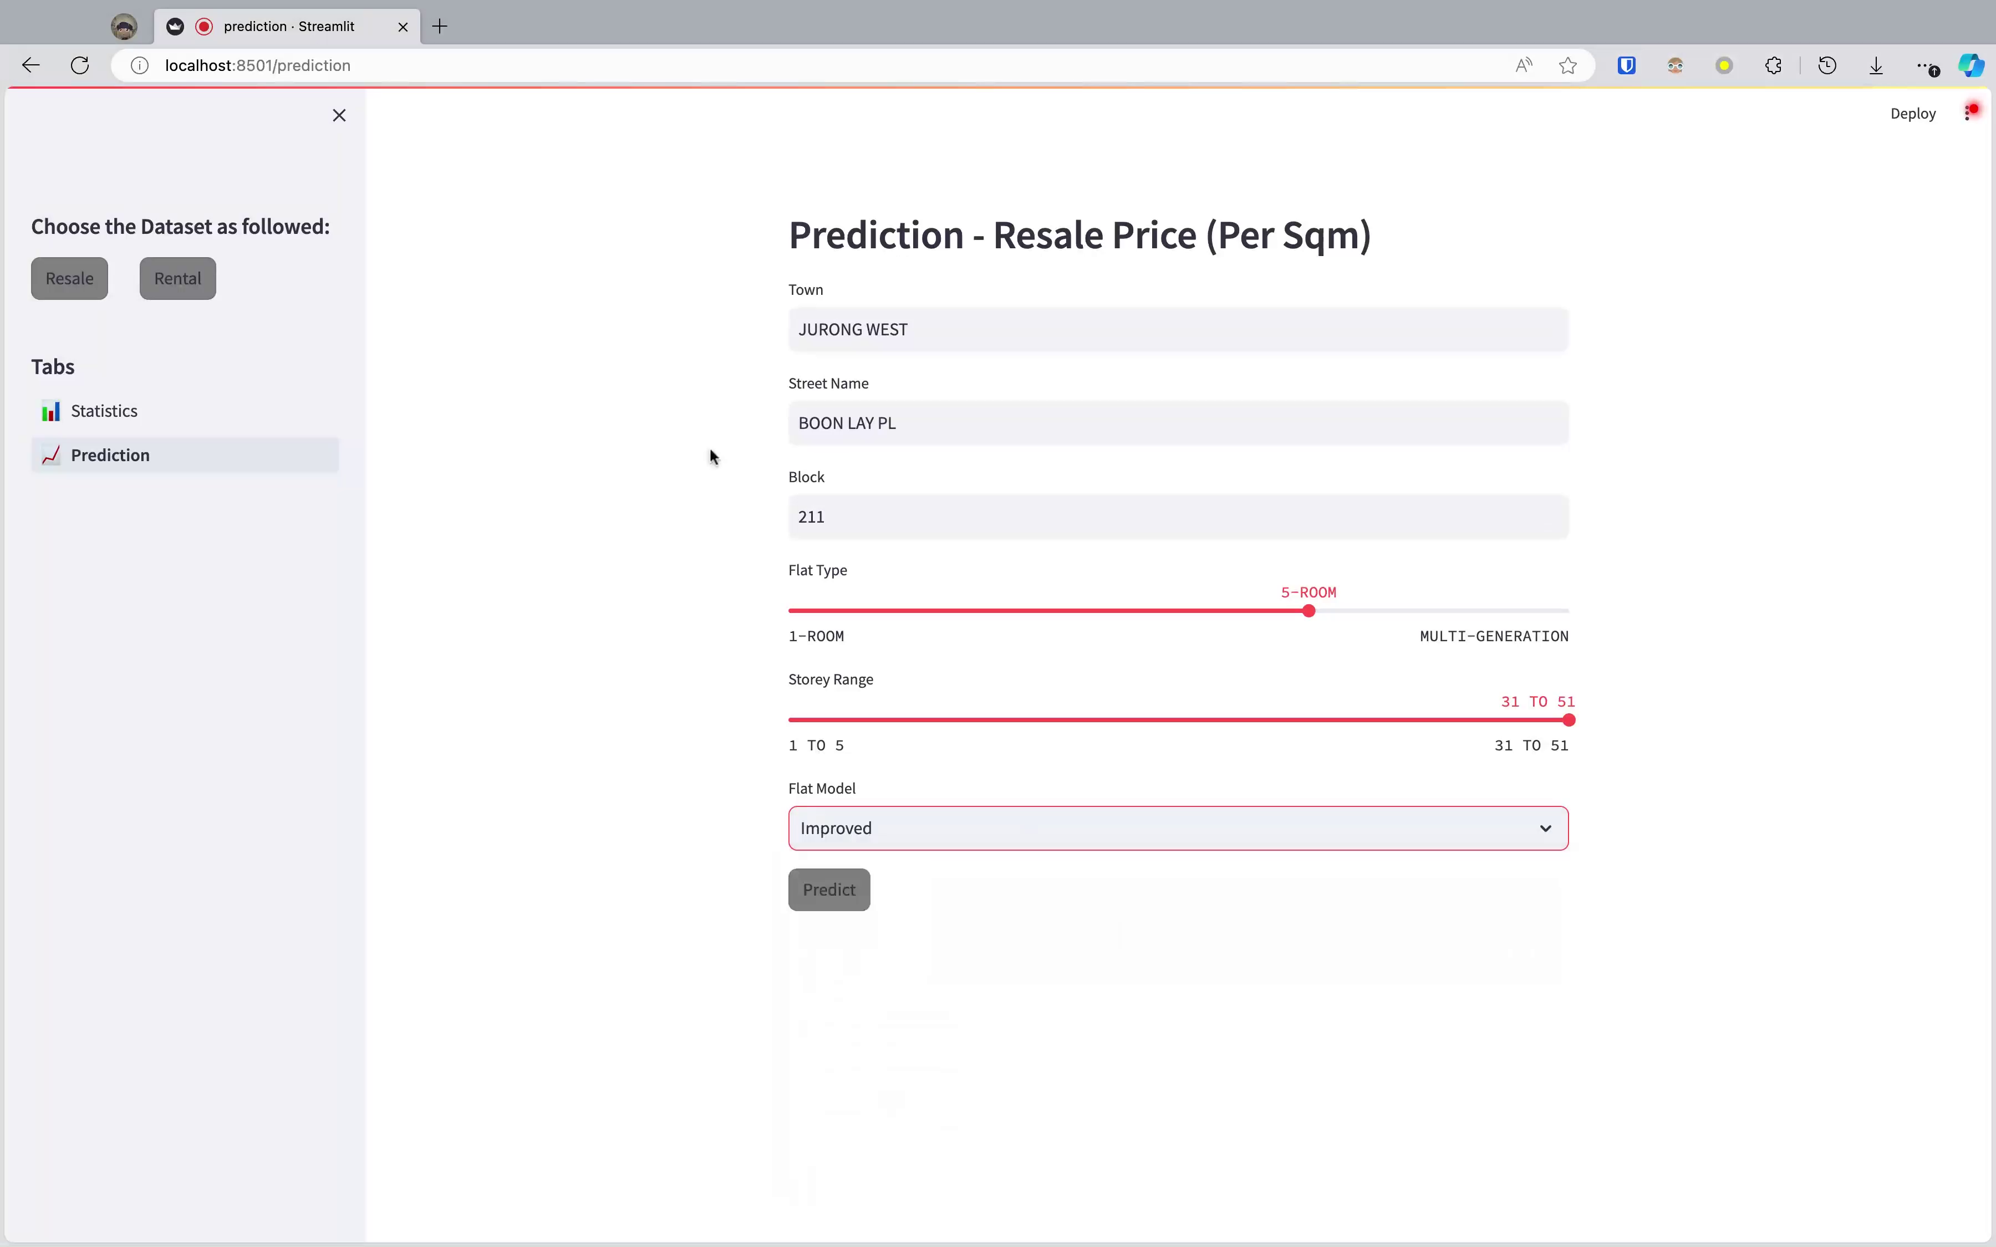

Slide 28
Thank you!

